Slide 1
Aushapur(V), Ghatkesar(M) , R.R Dist-50130
DEPARTMENT OF ELECTRONICS AND COMMUNICATION ENGINEERING
MAJOR PROJECT ON
COVID-19 DETECTION AND SAFETY MEASURE AUTOMATION USING ARDUINO
Guided By:
Mrs. S. Preethi Assistant Professor
AG1
Cheela Shashank Akkaldevi Hemanth
(17P61A0429) (17P61A0403)
E. Bhanu Prakash Goud (17P61A0442)
K. Sai Prasad (17C21A0411)

Slide 2
CONTENTS
Abstract
Literature Survey
Block Diagram
Hardware / Software Requirements
Circuit Diagram
Prototype
Working
Results
Advantages and Applications
Future Scope
Conclusion
References

Slide 3
ABSTRACT
The project will help people to detect Covid-19 affected persons to provide safe entrances.
It consists of Arduino Uno boards and RFID kit which are the main components in building a complete project. We used different types of sensors by realizing their concept where they work precisely and accurately.
It can also be used as a ‘Two level security system’ with the help of temperature sensors and buzzers which are integrated to the Arduino.
The major part that constitute is the ‘Robotic Arm’ which helps to deliver the goods or products to the customers without any contact.
A combination of ultrasonic sensors and servo motors which help dispensing the liquid sanitizer and the tissue papers.
We also introduced a ‘Smart Bin’ which stores the tissue papers after dispensing, that helps to keep the place neat and clean.

Slide 4
LITERATURE SURVEY
This pandemic requires utmost safety for each and every person to be safe and healthy . As we analyze the present situation, the count of affected persons is increasing in high rate.
Within a short span of the COVID-19 pandemic, many researchers have shared their works on teaching and learning in different ways.
We are currently now in a situation where we cannot step out of our homes without taking at most precautions to protect ourselves form this deadly virus.
Number of articles and research papers have been published regarding the seriousness of the situation as well as the precautions that needs to be taken to make sure everyone is safe.
So our prototype is completely contactless which helps people to detect covid-19 affected persons to provide safe entrances and sanitization.
Various concepts of sensors and their uses have been studied and their functionality has been learnt.

Slide 5
The current system and the components have been used after a brief study and checking the compatibility of the various sensors and software.
Multiple research papers have been taken as reference study and with the knowledge gained from the papers have been put to use for the building of this prototype.
Different scenarios and conditions of a space have been taken under consideration so as to build a resourceful project.
.

Slide 6
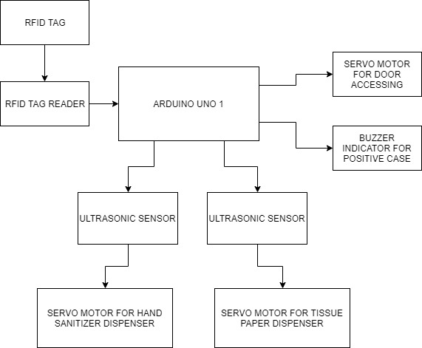
BLOCK DIAGRAM

Slide 7
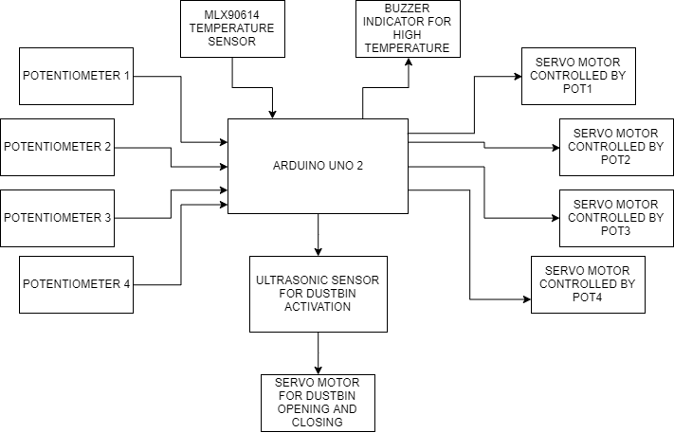
BLOCK DIAGRAM

Slide 8
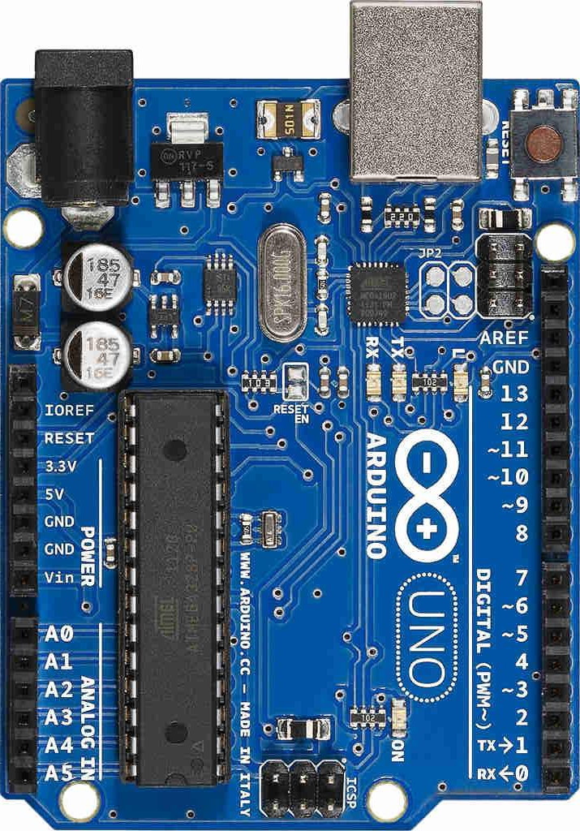
Requirements
Arduino Uno:
The Arduino UNO is an open-source microcontroller board based on the Microchip ATmega328P microcontroller and developed by Arduino.cc.
The board is equipped with sets of digital and analog input/output (I/O) pins that may be interfaced to various expansion boards (shields) and other circuits.
Arduino Uno consists of USB interface, 14 digital I/O pins, 6 analog pins, and Atmega328P microcontroller. It also supports serial communication using Tx and Rx pins.

Slide 9
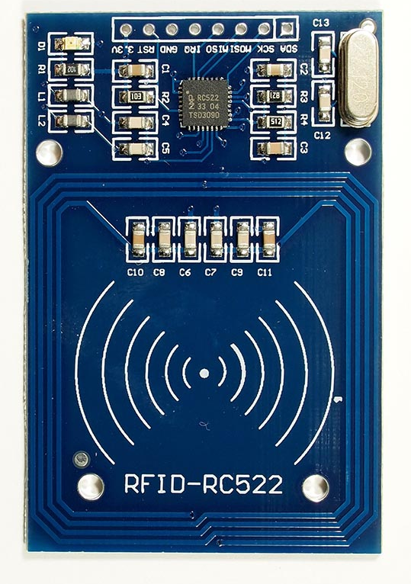
Requirements
RC522 RFID Reader:
RFID or Radio Frequency Identification system consists of two main components, a tag and a Reader.
The RC522 has an operating voltage between 2.5V to 3.3V and hence is normally powered by 3.3V
Hardware Features:
Frequency range – 13.56MHz
Operating voltage – 2.5V to 3.3V
Max operating current – 13-26mA
Host interfacing – SPI/I2C/UART

Slide 10
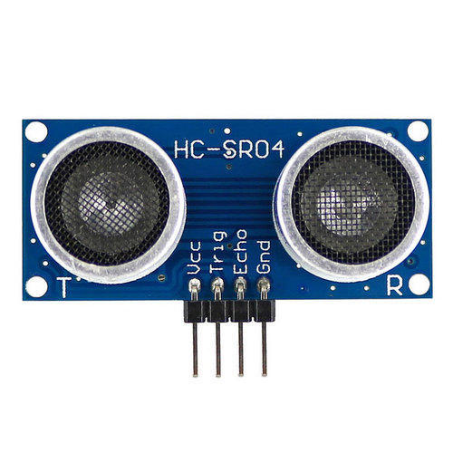
Requirements
HC-SR04 Ultrasonic Sensor:
HC-SR04 Ultrasonic sensor is a 4 pin module, whose pin names are Vcc, Trigger, Echo and Ground respectively.
It transmits a ultrasonic wave, this wave travels in air and when it hits an object it gets reflected back toward the sensor this reflected wave is observed by the Ultrasonic receiver module.
Hardware Features:
Practical measuring distance – 80cm
Operating voltage – 5V
Operating current – <15mA
Operating frequency – 40Hz
Measuring angle covered – <15°

Slide 11
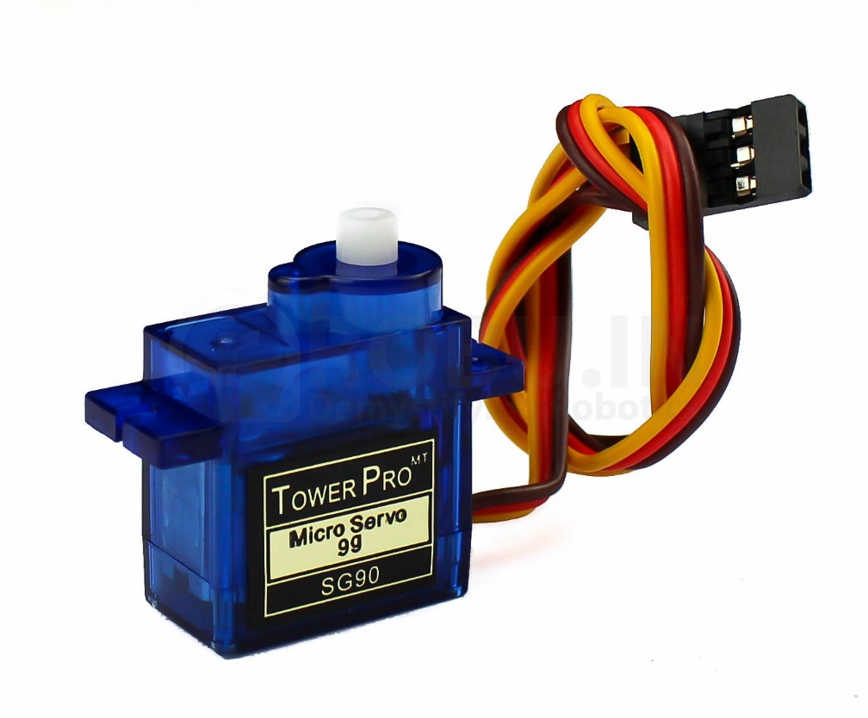
Requirements
SG-90 Servo Motor:
A servomotor is a rotary actuator or linear actuator that allows for precise control of angular position.
It consists of a suitable motor coupled to a sensor for position feedback.
Hardware Features:
Rotation – 0°-180°
Operating voltage – 5V
Torque – 2.5kg/cm
Weight – 9gm
Operating speed – 0.1s/60°

Slide 12
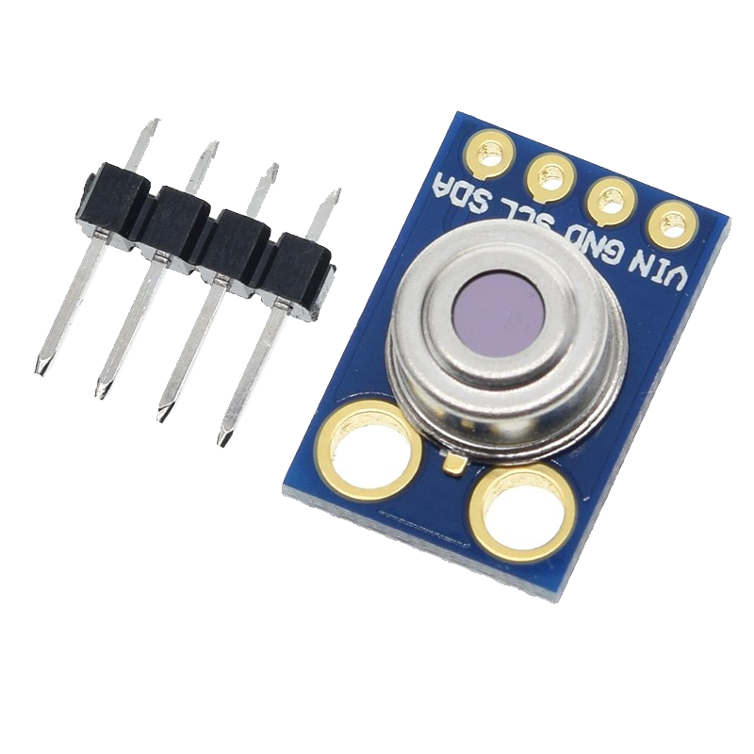
Requirements
MLX90614 Contactless Temperature Sensor:
MLX90614 is a contactless temperature sensor, which senses the temperature using IR waves and gives the data as input.
Due to it’s accuracy, it is used in commercial spaces, medical, health care and house hold applications.
Hardware Features:
Operating voltage – 3.3V
Object temperature – 86°-107° F
Room temperature – 50°-104° F
Accuracy – 0.02° C
Field of view – 80°
Operating distance – 2cm-5cm

Slide 13
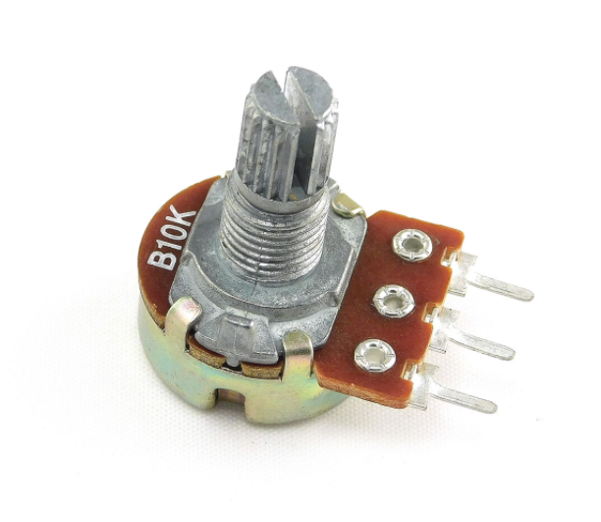
Requirements
10K Potentiometers:
A potentiometer is a three-terminal resistor with a sliding or rotating contact that forms an adjustable voltage divider.
Potentiometers are commonly used to control electrical devices such as volume controls on audio equipment.
Hardware Features:
Power rating – 0.3W
Max input voltage – 200Vdc
Type - Rotational
Rotational cycles – 200K cycles
Variation type – Linear

Slide 14
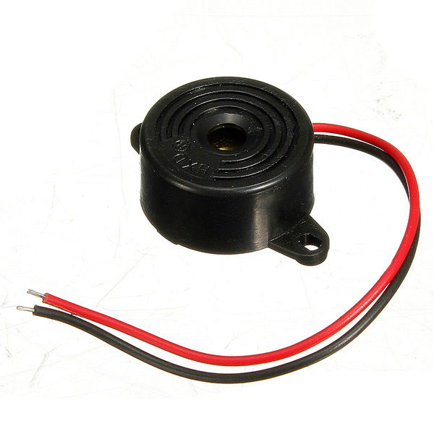
Requirements
Active Passive Buzzer:
Active Passive Buzzer as their name, consists of two wires. One positive and the other one being negative or ground.
When connected to the system and providing the power supply, it provides a continuous beep sound.
Hardware Features:
Operating voltage – 4-8V
Operating current - <30mA
Frequency – ~2300Hz
Terminals – +VE and -VE
Body type – Plastic casing

Slide 15
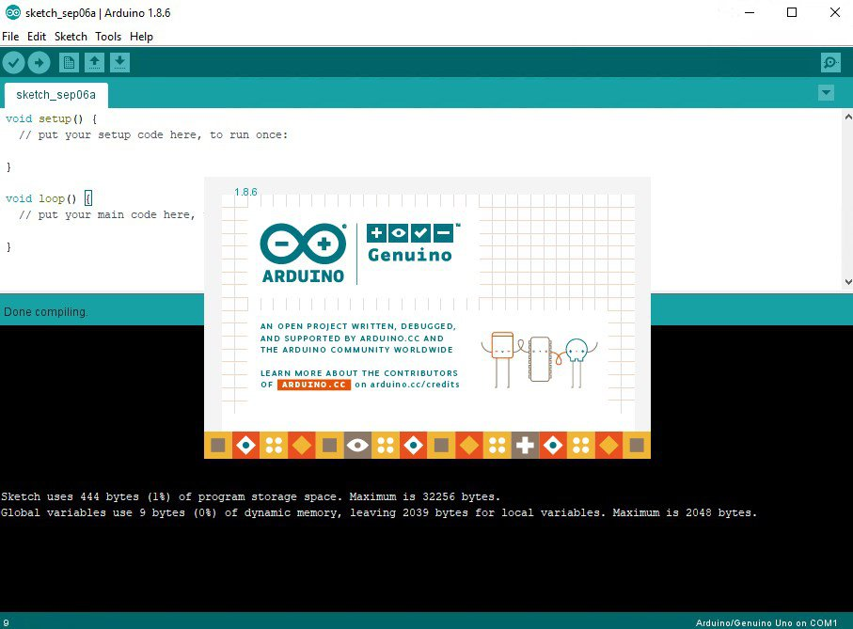
Software Requirements
Arduino IDE Software:
A program for Arduino hardware may be written in any programming language with compilers that produce binary machine code for the target processor
The Arduino integrated development environment(IDE) is a cross-platform application (for Windows, macOS, Linux) that allows users to write and upload code with in a real-time environment.

Slide 16
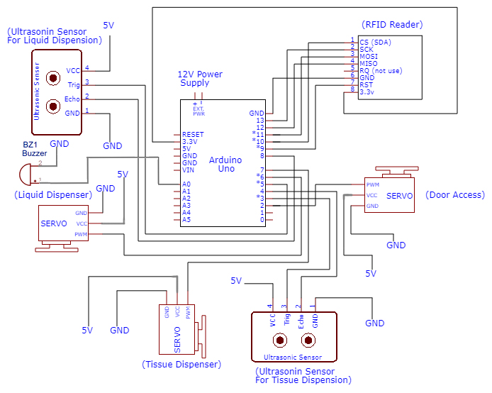
CIRCUIT DIAGRAM

Slide 17
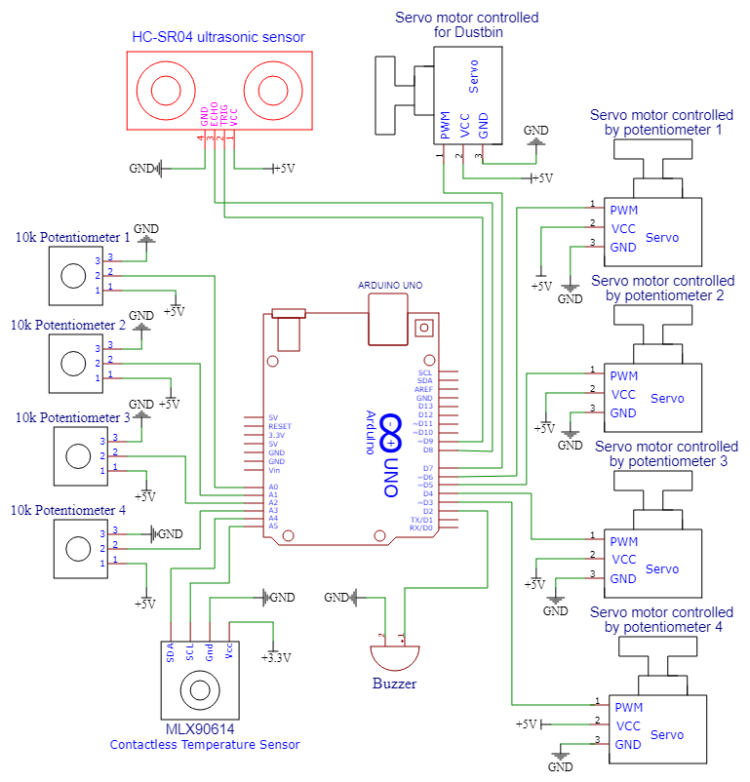
CIRCUIT DIAGRAM

Slide 18
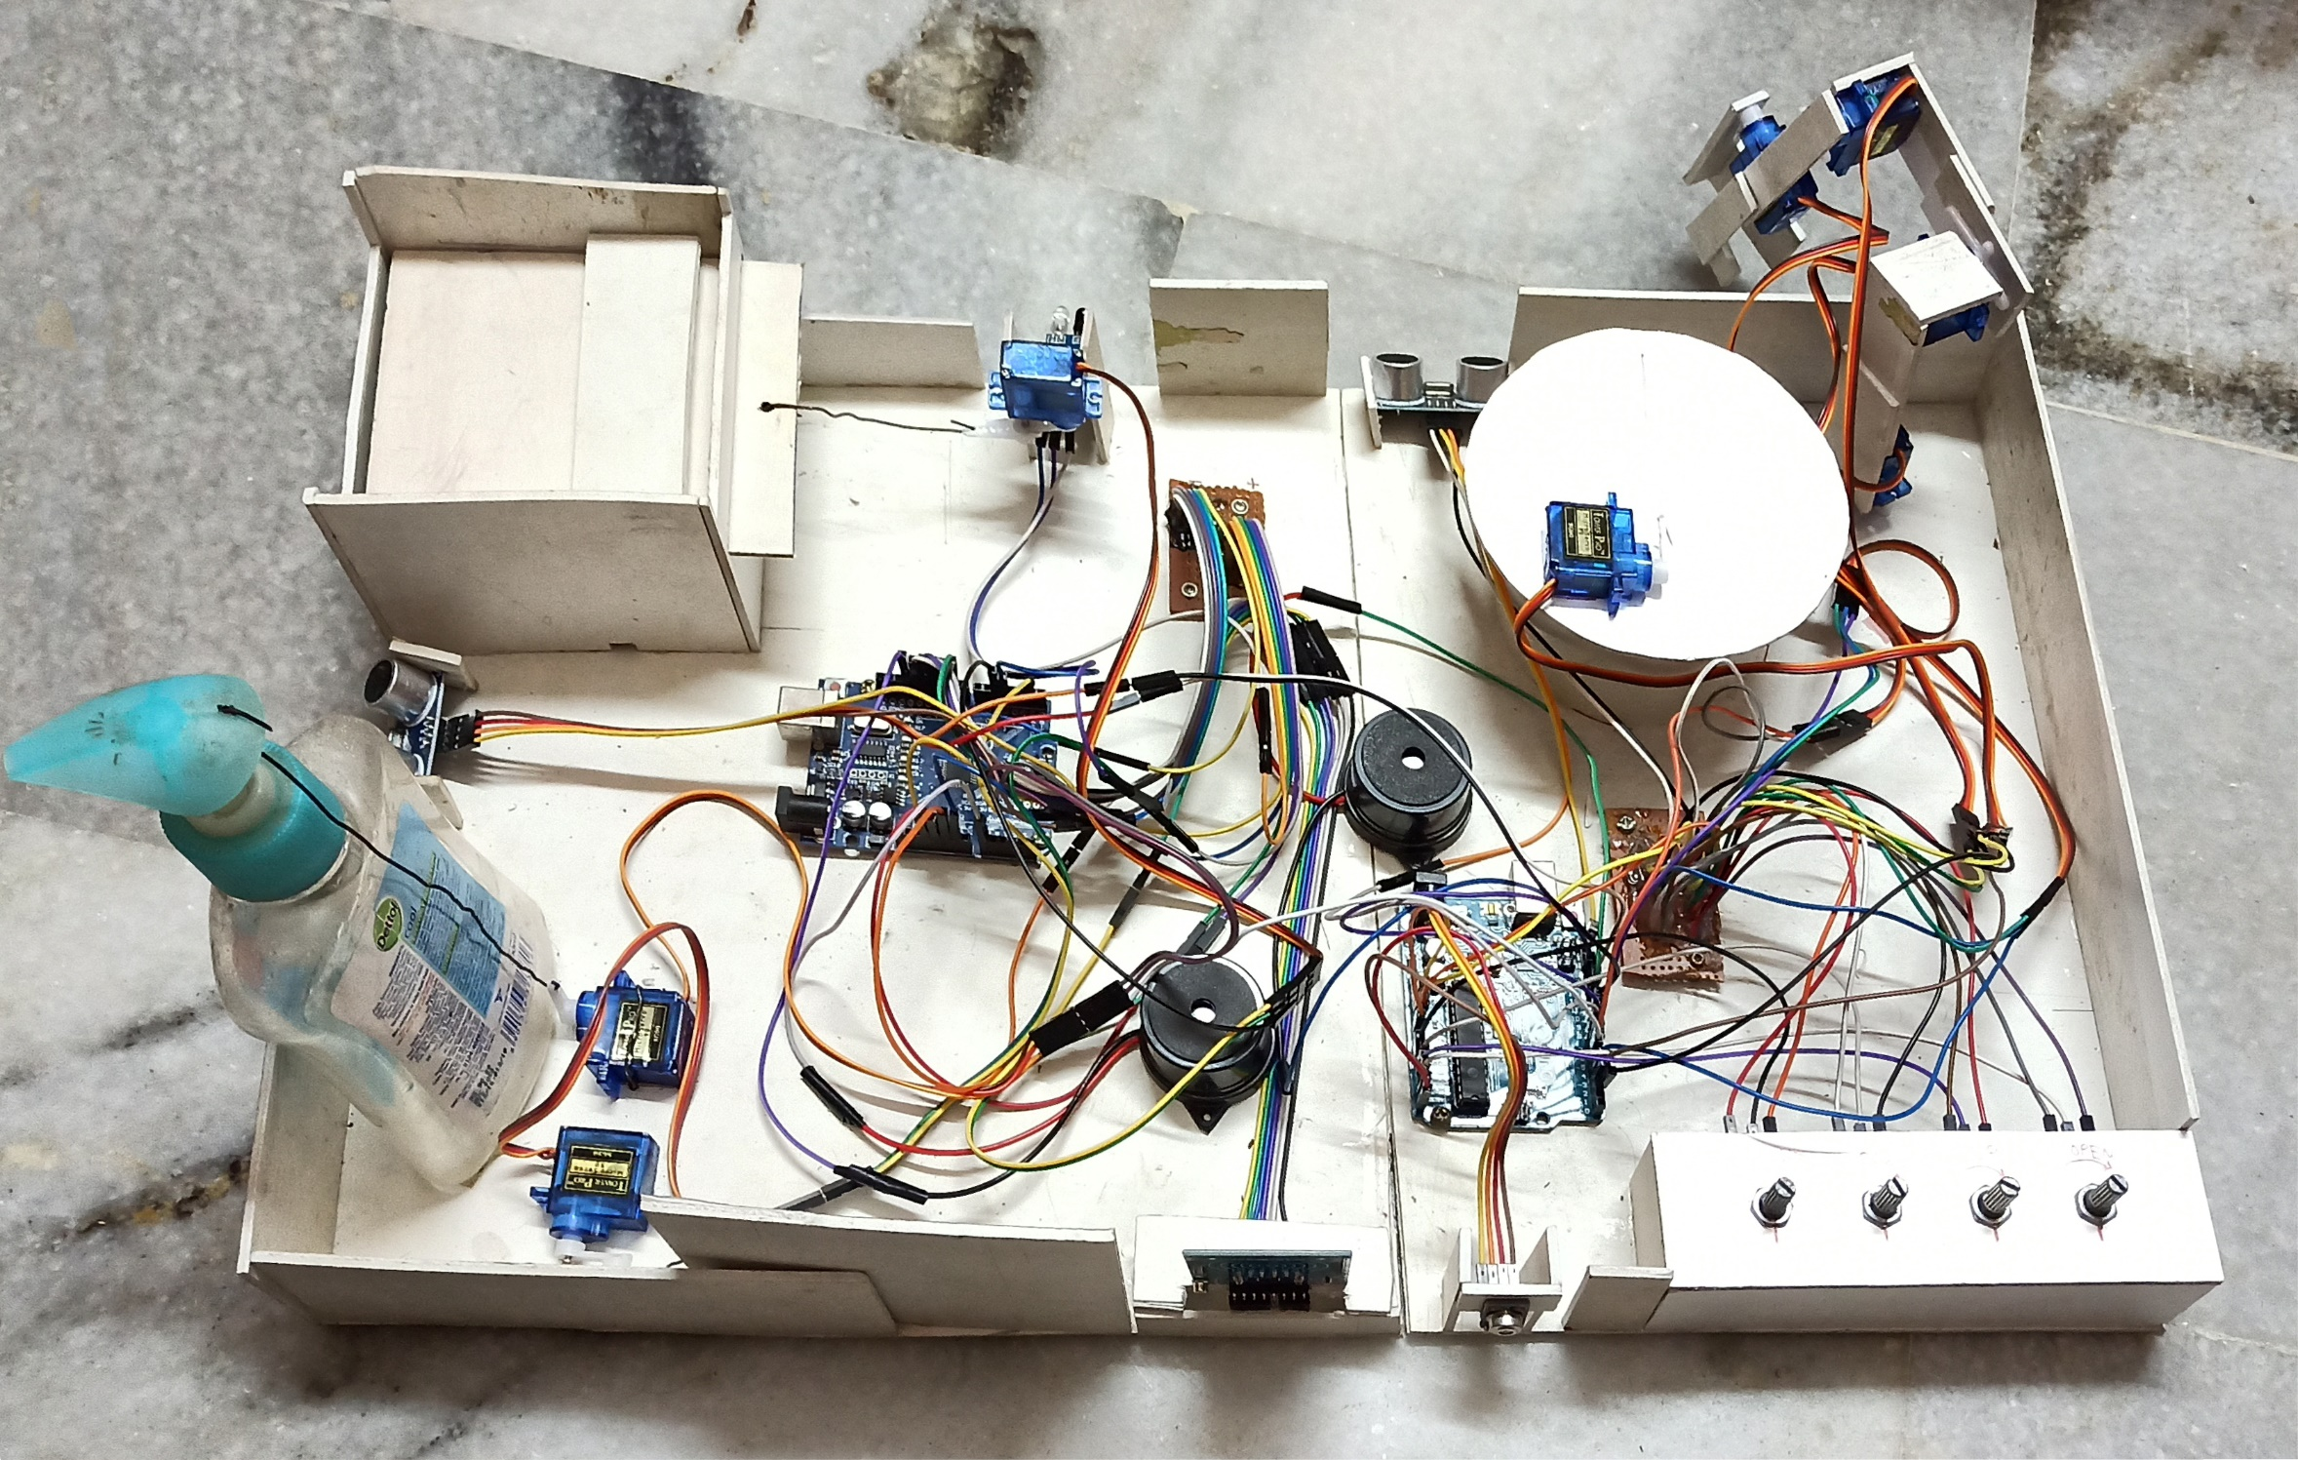
PROTOTYPE

Slide 19
WORKING
The previous mini project consisted of the RFID tag which provides access to the when the Tag reads as “Negative” and denies access if it reads otherwise and alarms the authorities with the help of the buzzer.
It also consisted of Sanitizer dispenser and the tissue paper dispensers as a part of it which dispense when the person puts his hands in front of the ultrasonic sensors and the servo motors.
For the extension of the project we have used MLX90614 contactless temperature sensor which receives the infrared waves transmitted from a body.
A buzzer has been interfaced with the temperature sensor, when the temperature of the body is above 101°F, then the buzzer alarms the authorities to take precautions.
A Robotic Arm is the major addition to the prototype and is a combination of 10K Potentiometers and servo motors, which helps the delivery of the products to the customers without contact.
When the potentiometer is turned, the resistance is increased and the data is sent to the Arduino via analog inputs which control the rotation of the servo motors.

Slide 20
In addition to the mini project, we have built a contactless dustbin which works with the combination of ultrasonic sensor and a servo motor.
The person needs to place his hands in front of the sensor, when the distance between the sensor and the hand is less than 10CM then the sensor sends the signal to the servo motor.
When the servo motor receives the signal, it opens the mouth of the dustbin so that the person can throw the used tissue papers or the waste materials in the bin.

Slide 21
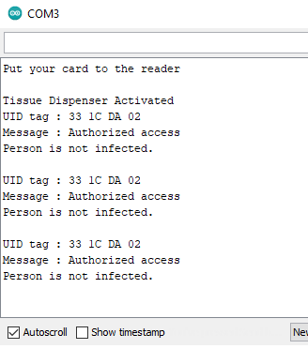
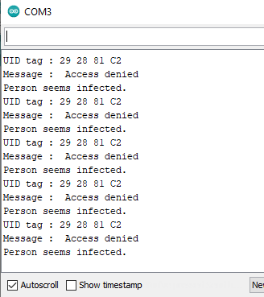
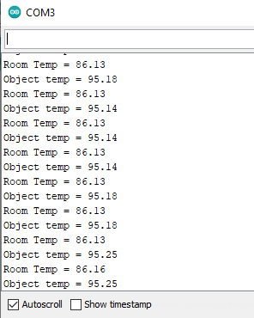
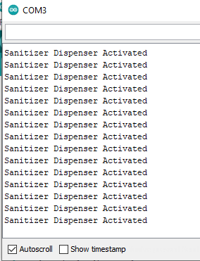
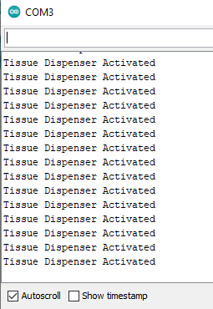
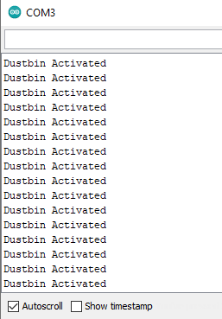
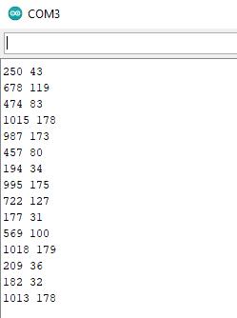
RESULTS
Access Granted
Access Denied
Temperature Sensor
Sanitizer Dispenser
Tissue Dispenser
Garbage Dustbin
Potentiometer Readings

Slide 22
ADVANTAGES
Easy detection of Covid affected persons
Increases the security
Highly compatible and a low cost equipment
Accurate and can be operated without any contact
Reduces labor to provide access into the space, hence avoiding the person from being affected by the virus

Slide 23
APPLICATIONS
It can be used in organizations and stores where the people have access to
Used to deliver the products to the customers without any contact using the Robotic Arm
It also helps to sanitize using liquid disinfectants, ultrasonic proximity sensors and servo motors
The Smart Bin is used to throw away the dispensed tissue papers after use

Slide 24
CONCLUSION
The prototype using Arduino microcontroller and different types of sensors is proposed to ensure the safety of the person at these prior situations prevailing now. With the use of different types of sensors enhances the process of being completely contactless. Being completely contactless, our prototype gets its own importance though we cannot completely destroy the virus but it ensures to decrease the spread of the virus.

Slide 25
FUTURE SCOPE
More compact components and low cost equipment
Data base could be taken from the government such that it could be used pan India
System could be developed such that it can be implemented in every place
For the Robotic Arm, a set of wheels could be added for its movement.
More applications could be added to the system depending on the situation

Slide 26
REFERENCES
Nath, S., Banerjee, P., Biswas, R. N., Mitra, S. K., & Naskar, M. K. (2016). Arduino based door unlocking system.
Bakht, K., Din, A. U., Shehzadi, A., & Aftab, M. (2019). Design of an Efficient Authentication and Access Control System Using RFID. 2019 3rd International Conference on Energy Conservation and Efficiency (ICECE).
Kassim, A. M., Jaafar, H. I., Azam, M. A., Abas, N., & Yasuno, T. (2013). Performances study of distance measurement sensor with different object materials and properties. 2013 IEEE 3rd International Conference on System Engineering and Technology.
Bhargava, A., & Kumar, A. (2017). Arduino controlled robotic arm. 2017 International Conference of Electronics, Communication and Aerospace Technology (ICECA).

Slide 27
THANK YOU

